Slide 1
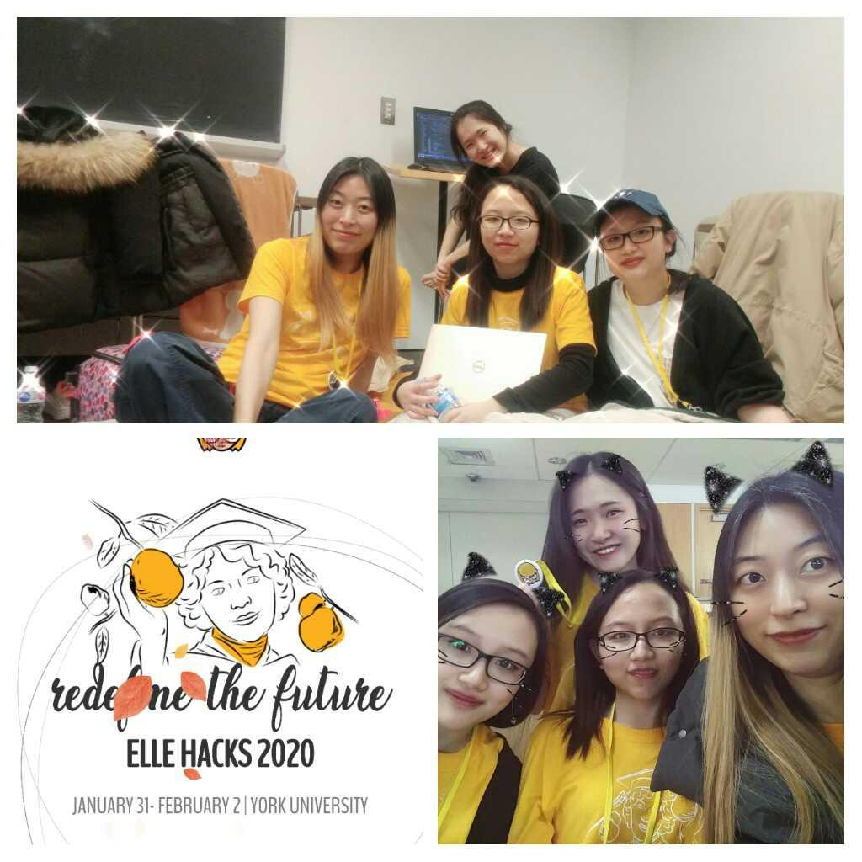

The Pavilion Team
Back-End
Eunbee Kim
Steffy Lo
Front-End
Jihyun Lee
Victoria Lo
/eunbeek
/azurerr
/steffy-lo
/victoria-lo

Slide 2
“Loneliness and the feeling of being unwanted is the most terrible poverty.”
Mother Teresa
A Presentation by The Pavilion Team
ElleHacks 2020
Notes:
Hi, my name is Victoria and today I’ll be talking about the solution that my team and I put together for this hackathon to battle loneliness, which according to Mother Teresa, is the most terrible poverty.

Slide 3
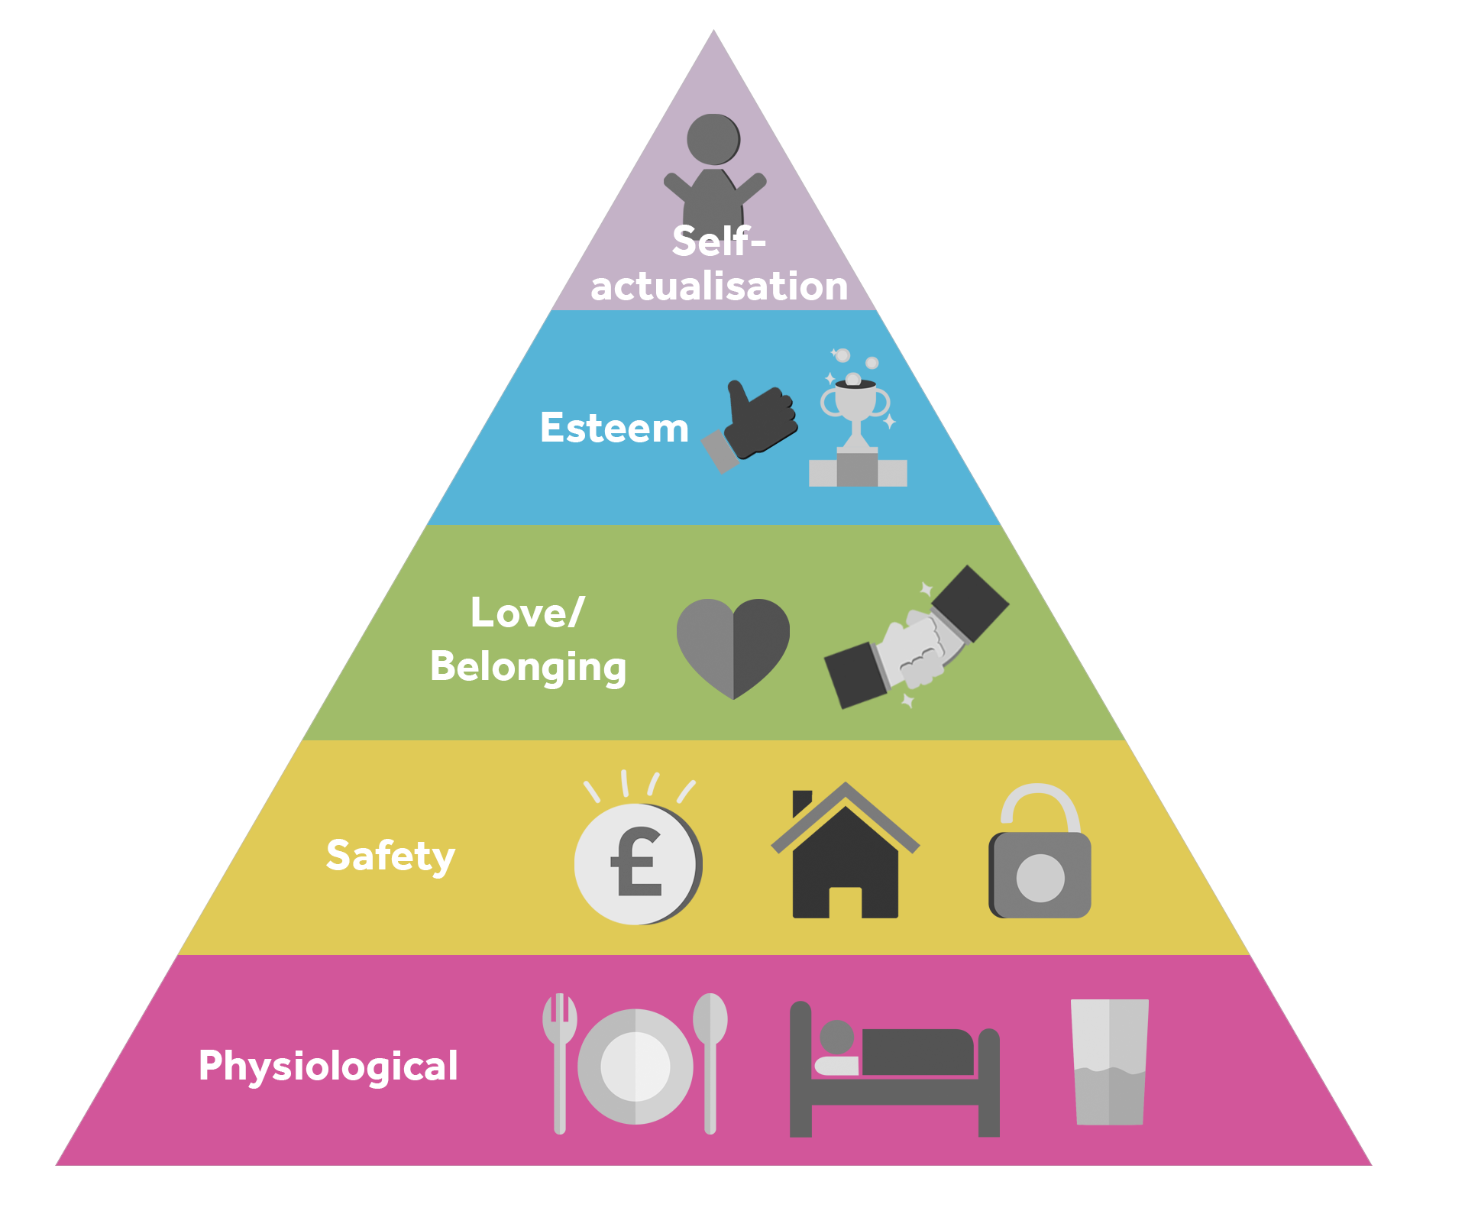
The Age of Loneliness
Maslow’s Hierarchy of Needs
Impact on Mental Health
> Depression, Alzheimer’s, Substance Abuse, Personality Disorders, Premature Deaths, etc.
Source: Mushtaq, R. (2014). Relationship Between Loneliness, Psychiatric Disorders and Physical Health. Journal Of Clinical And Diagnostic Research. doi: 10.7860/jcdr/2014/10077.4828
Notes:
In short, our society is now facing the age of loneliness crisis. The Maslow’s Hierarchy of Needs illustrates that our need for a sense of belonging comes right after our physiological (food, sleep, water) and safety (finance, security) needs are met. 20 years ago, there may be more people just trying to achieve the first 2 needs but today, with our 1st 2 needs being met so easily, people began desiring a need for belonging. According to a 2014 study,

Slide 4

Our Solution
Pavilion /pəˈvilyən/
an easy-to-use, social platform which gathers individuals with common enjoyable interests to form groups and a sense of belonging.
Notes:
VIC

Slide 5
Mental Health → Sustainability
UN Sustainable Development Goals
“By 2030, reduce 1/3 premature mortality from noncommunicable diseases through prevention and treatment and promote mental health and well-being.”
Source: https://www.who.int/mental_health/SDGs/en/
Notes:
We see 2 values from our proposed solution. One is preventing loneliness, which naturally promotes mental care. And this ties to the 2nd value, sustainability, as one of UN’s SDGs is to reduce premature mortality by promote mental health and well being.

Slide 6



Why Pavilion?
Promotes Offline Interaction
¹Online friends have no impact on well-being while offline friends boost positive emotions.
Anytime.
Anywhere.
Connects people in close proximity for spontaneous activities
Fosters
Belongingness
Connects users who desire to make connections via common interests
¹Wilson, J. (2013, September 18). Online Friends Don't Deliver Offline Happiness. Retrieved from https://www.goodtherapy.org/blog/online-friends-dont-deliver-offline-happiness-0918131
Notes:
In addition to these values, pavilion promotes that human to human interaction which are slowly lacking in today’s society due to the increased in online activities. N studies have shown that online interaction does not affect one’s well being while having offline friends or face-to-face social interaction boost positive emotions. Our platform also emphasizes on its spontaneity by matching with people very near from each other so you can meet up anytime, anywhere whenever u want to meet. By connecting ppl with similar interests, they can meet others outside their usual social circle and meet diverse ppl that they would not meet. For lack of better words, this platform gives people a reason to meet and make new connections that forsters belonging. despite different careers age gender etc.

Slide 7









Technologies Used
Notes:
Radar: track user location
MongoDB: store user data, profiling information such as age, gender, address

Slide 8



Next Steps - The Future of Pavilion
Filter Search
Filtering search results based on age group and gender in addition to activities
Carpool Options
Drivers can be dispatched to pick up users who are planning to meet
Mobile App
Will be available for iOS and Android

Slide 9



Thank You!
Let’s stay happy and connected with
github.com/eunbeek/pavilionbyllk
https://pavilionbyllk.herokuapp.com/
Notes:
STEFFY

